Slide 1



Adsorption & Absorption
of Push-Pull Functionalized Stilbene on an Amorphous Silica Glass
Dóra Vörös
Supervisors: Leticia González & Sebastian Mai
Libra Summer School 8. June 2024

Slide 2

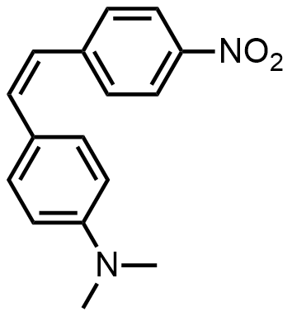
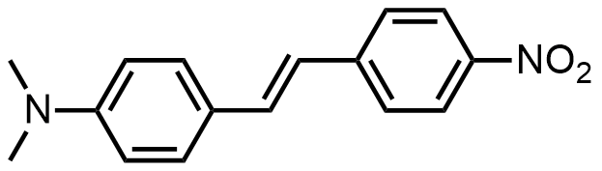
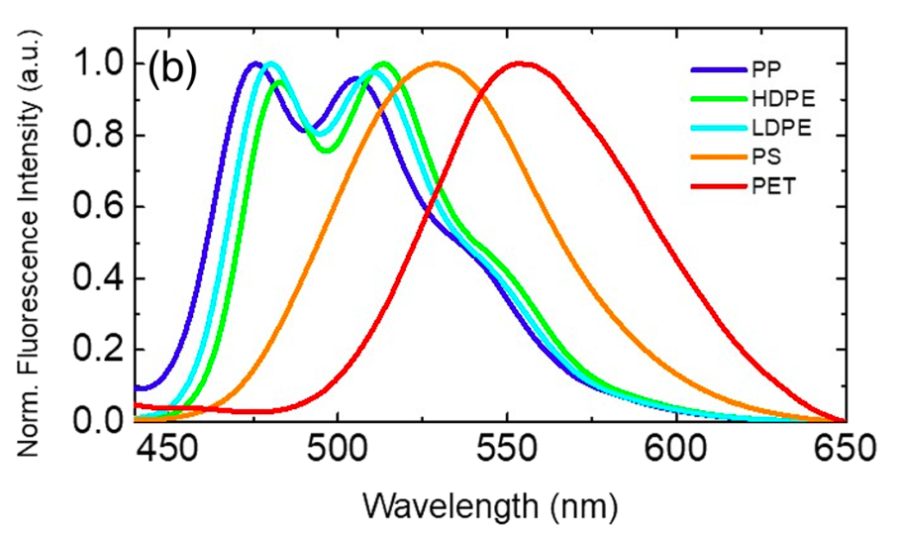
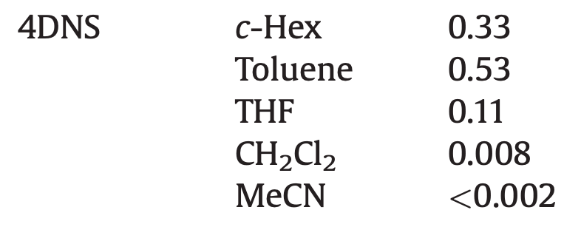
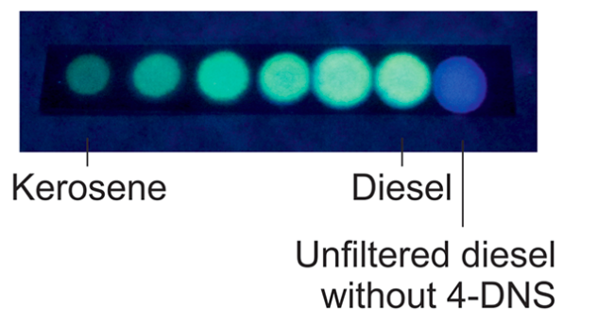
My DANSers
Fluorescence
4‑(N,N-Dimethylamino)-4′- nitrostilbene (DANS)
Isomerization/initial isomer
Detection of microplastics²
Detection of adulterated diesel³
Fluorescence yield¹
Libra Summer School 2024
polypropylene (PP)
low-density polyethylene (LDPE)
high-density polyethylene (HDPE)
polystyrene (PS)
polyethyleneterephtalate (PET)
Dóra Vörös
¹Yang, J. S., & Lin, C. J. (2015). Fate of photoexcited trans-aminostilbenes. J. Photochem. Photobiol. A, 312, 107-120.
²Sancataldo, G., et al., (2021). Identification of microplastics using 4‐dimethylamino‐4′‐nitrostilbene solvatochromic fluorescence. Microsc. Res. Tech., 84(12), 2820-2831.
³Gotor R., et al., (2017). Detection of Adulterated Diesel Using Fluorescent Test Strips andSmartphone Readout. Energy & Fuels, 31, 11594-11600.
Notes:
adulteration of diesel withkerosene which contains a higher level of sulfur results in theemission of SOxderivatives to the atmosphere
A chemical system based on 4-DNS, a well-knownfluorescentmolecular rotor sensitive to viscosity, was used to obtain simpleand efficient test strips for the detection of diesel fueladulteration.
Screenshot 2024-04-03 at 15.19.48

Slide 3
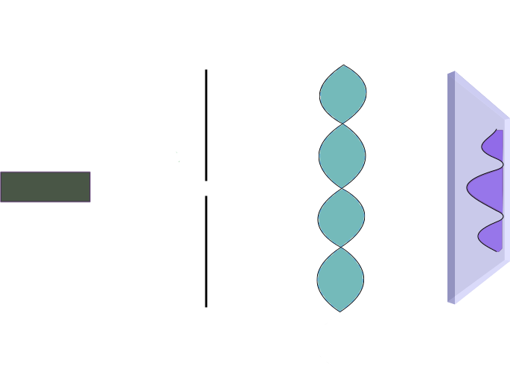

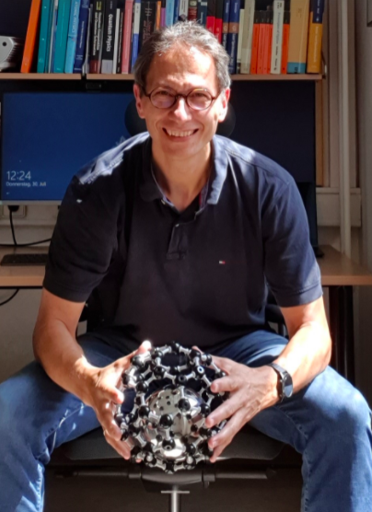

My DANSers
Fluorescence
4‑(N,N-Dimethylamino)-4′- nitrostilbene (DANS)
Isomerization/initial isomer
Libra Summer School 2024
Prof. Markus Arndt
Detection on glass via fluorescence microscopy
Create molecular beam
Ksenija Simonović
Filter
Dóra Vörös
Optical grating
Brand, Christian, et al. "Bragg diffraction of large organic molecules." Physical Review Letters 125.3 (2020): 033604.
Notes:
adulteration of diesel withkerosene which contains a higher level of sulfur results in theemission of SOxderivatives to the atmosphere
A chemical system based on 4-DNS, a well-knownfluorescentmolecular rotor sensitive to viscosity, was used to obtain simpleand efficient test strips for the detection of diesel fueladulteration.
Screenshot 2024-04-03 at 15.19.48

Slide 4
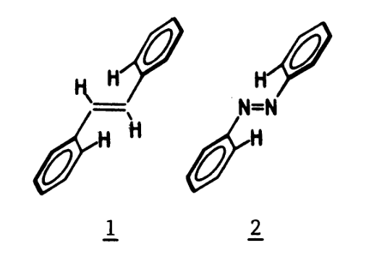
My DANSers
Fluorescence
4‑(N,N-Dimethylamino)-4′- nitrostilbene (DANS)
Isomerization/initial isomer
Libra Summer School 2024
Dóra Vörös
Oelkrug, D., et. Al (1986). Photochemistry on surfaces. Pure and Applied Chemistry, 58(9), 1207-1218.
Notes:
adulteration of diesel withkerosene which contains a higher level of sulfur results in theemission of SOxderivatives to the atmosphere
A chemical system based on 4-DNS, a well-knownfluorescentmolecular rotor sensitive to viscosity, was used to obtain simpleand efficient test strips for the detection of diesel fueladulteration.
Screenshot 2024-04-03 at 15.19.48

Slide 5
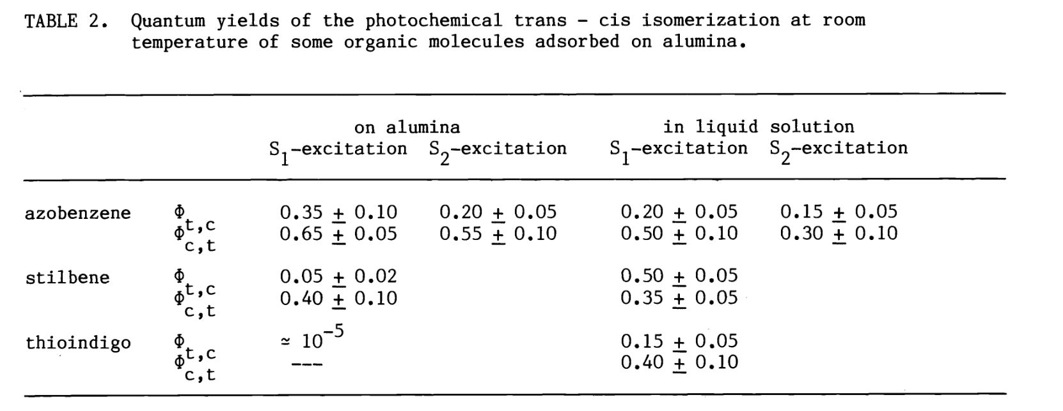
My DANSers
Fluorescence
4‑(N,N-Dimethylamino)-4′- nitrostilbene (DANS)
Isomerization/initial isomer
Libra Summer School 2024
Dóra Vörös
Oelkrug, D., et. Al (1986). Photochemistry on surfaces. Pure and Applied Chemistry, 58(9), 1207-1218.
Notes:
adulteration of diesel withkerosene which contains a higher level of sulfur results in theemission of SOxderivatives to the atmosphere
A chemical system based on 4-DNS, a well-knownfluorescentmolecular rotor sensitive to viscosity, was used to obtain simpleand efficient test strips for the detection of diesel fueladulteration.
Screenshot 2024-04-03 at 15.19.48

Slide 6

Research Question
?
How the photophysics/photochemistry of DANS is influenced when it is adsorbed on glass?
Libra Summer School 2024
Dóra Vörös
Notes:
Easter eggs are hidden references, clues, or inside jokes placed in media such as TV shows, movies, video games, and websites.¹³ They are often hard to spot and may reveal new details about the story or pay homage to an inspiration that the creators loved.

Slide 7
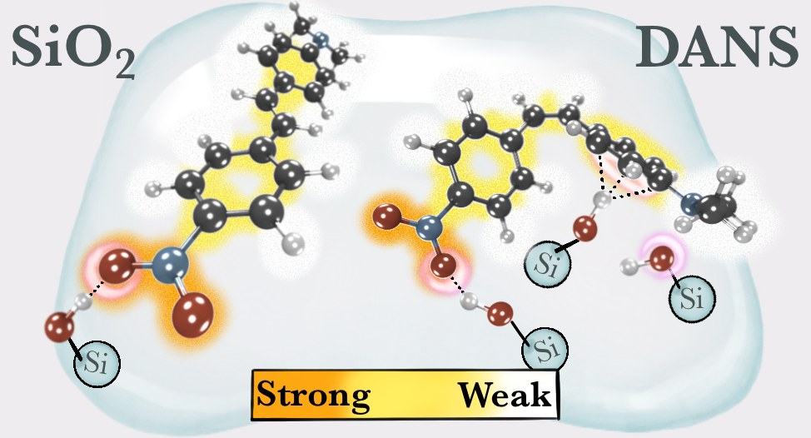
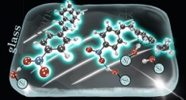
Goals
How does the molecule adsorb on the glass? Stable and unstable orientations?
Libra Summer School 2024
How does the absorption spectrum vary depending on the adsorption modes?
How does the nonradiative vs. radiative ratio change upon adsorption?
Dóra Vörös
Notes:
Easter eggs are hidden references, clues, or inside jokes placed in media such as TV shows, movies, video games, and websites.¹³ They are often hard to spot and may reveal new details about the story or pay homage to an inspiration that the creators loved.

Slide 8
Adsorption in the ground state
Prepare initial orientations
Relax/optimize these initial orientations within periodic boundary conditions at PBE/D3 level of theory and with plane-wave DFT
Repeat the calculations on 4 different surfaces
Libra Summer School 2024
Dóra Vörös
Vörös, D., Angeletti, A., Franchini, C., Mai, S., & González, L. (2023). Adsorption of 4-(N, N-Dimethylamino)-4′-nitrostilbene on an Amorphous Silica Glass Surface. The Journal of Physical Chemistry C, 127(47), 22964-22974.
Notes:
Easter eggs are hidden references, clues, or inside jokes placed in media such as TV shows, movies, video games, and websites.¹³ They are often hard to spot and may reveal new details about the story or pay homage to an inspiration that the creators loved.

Slide 9
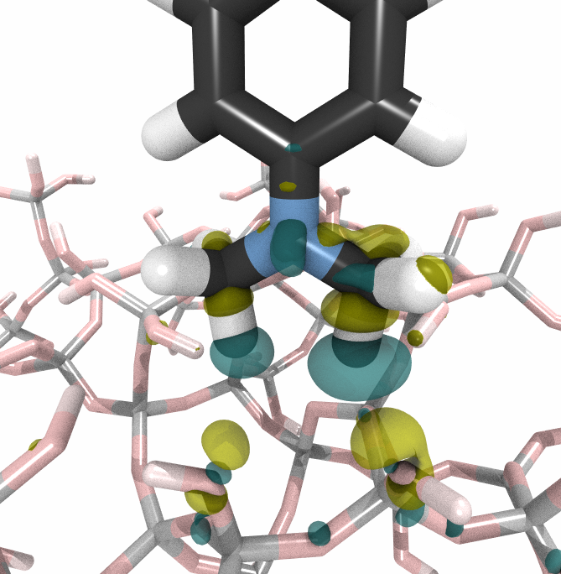
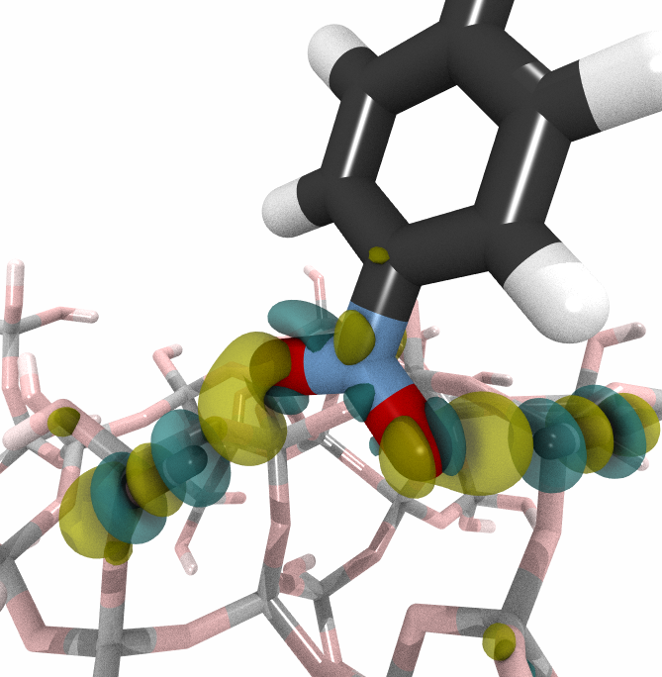
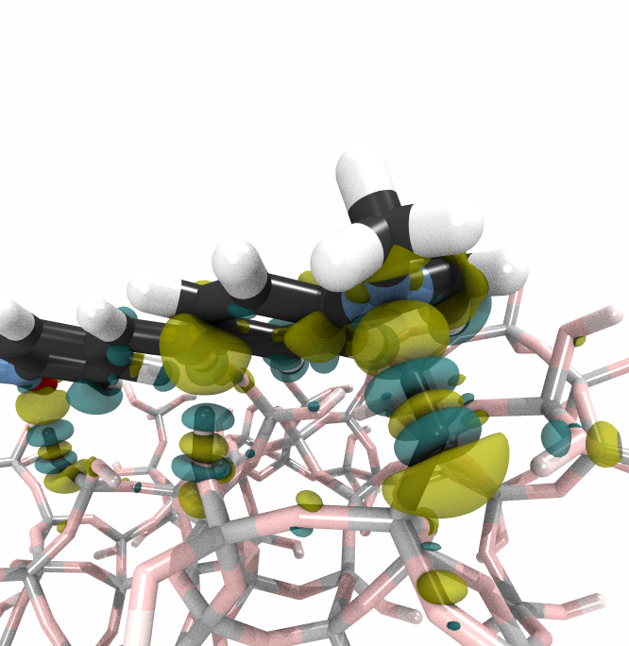
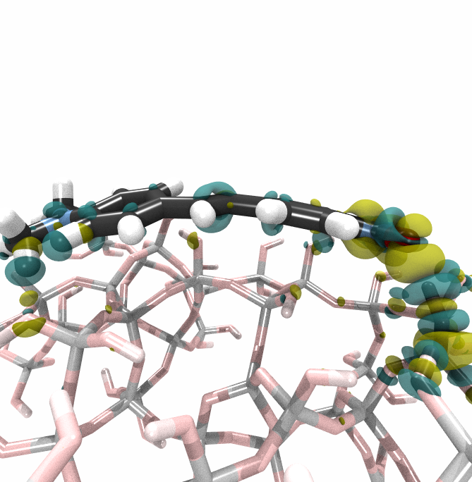
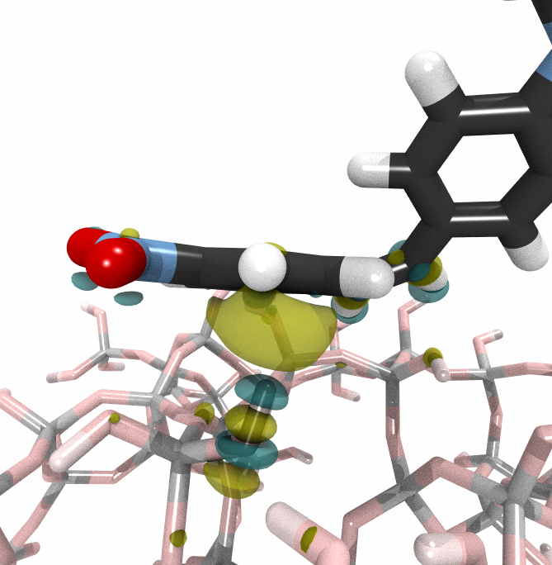





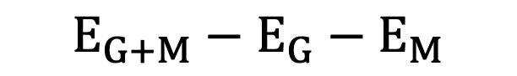
Interaction examples
Interaction energy/eV:
$$E_{G+M}−E_{G}−E_{M}$$
Charge density differences:
$$ρ_{G+M}−ρ_{G}−ρ_{M}$$
+
-
C-H$⋯$O
O-H$⋯$O
O-H$⋯N$
bended
O-H$⋯π$
Libra Summer School 2024
-0.38 eV
-0.85 eV
-1.77 eV
-2.18 eV
-0.69 eV
Dóra Vörös
Vörös, D., Angeletti, A., Franchini, C., Mai, S., & González, L. (2023). Adsorption of 4-(N, N-Dimethylamino)-4′-nitrostilbene on an Amorphous Silica Glass Surface. The Journal of Physical Chemistry C, 127(47), 22964-22974.
Notes:
Easter eggs are hidden references, clues, or inside jokes placed in media such as TV shows, movies, video games, and websites.¹³ They are often hard to spot and may reveal new details about the story or pay homage to an inspiration that the creators loved.

Slide 10
Goals
https://doi.org/10.1021/acs.jpcc.3c05552
How does the molecule adsorb on the glass? Stable and unstable orientations?
Libra Summer School 2024
How does the absorption spectrum vary depending on the adsorption modes?
How does the nonradiative vs. radiative ratio change upon adsorption?
Dóra Vörös
Notes:
Easter eggs are hidden references, clues, or inside jokes placed in media such as TV shows, movies, video games, and websites.¹³ They are often hard to spot and may reveal new details about the story or pay homage to an inspiration that the creators loved.

Slide 11
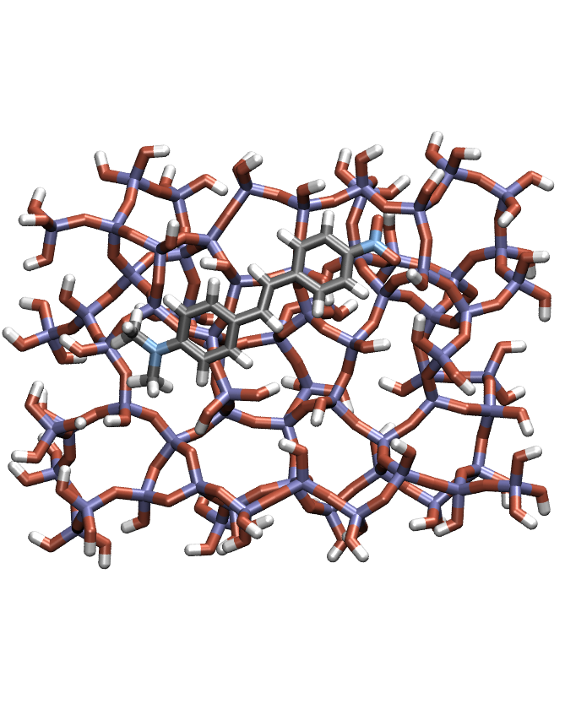
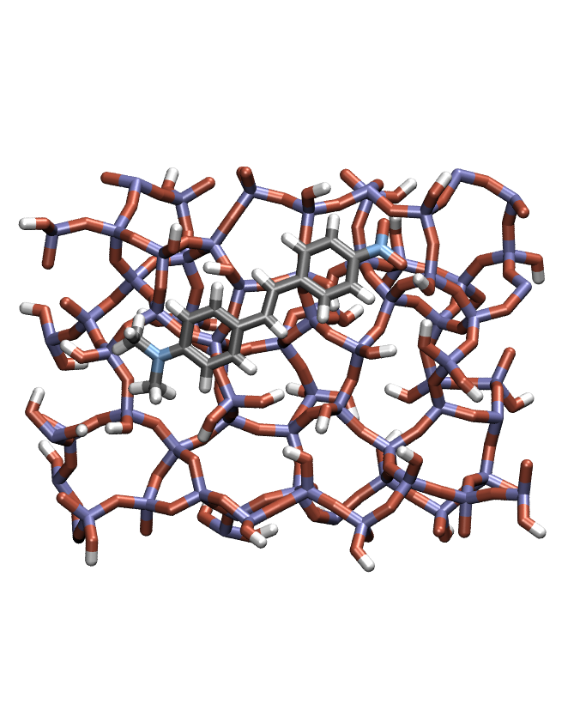
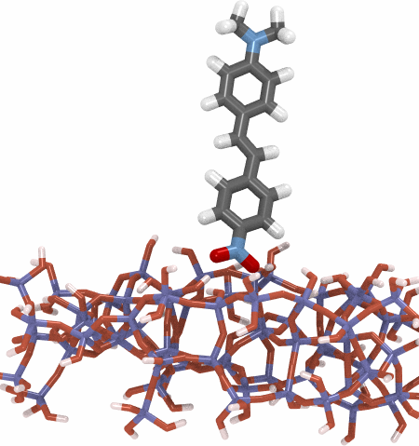
Computational details
Saturate a unit cell to remove dangling bonds and to obtain cluster
Single point calculations at TD-CAM-B3LYP/def2-SVP with TDA
Gaussian convolution to get absorption spectrum
Libra Summer School 2024
Dóra Vörös
Notes:
Easter eggs are hidden references, clues, or inside jokes placed in media such as TV shows, movies, video games, and websites.¹³ They are often hard to spot and may reveal new details about the story or pay homage to an inspiration that the creators loved.

Slide 12
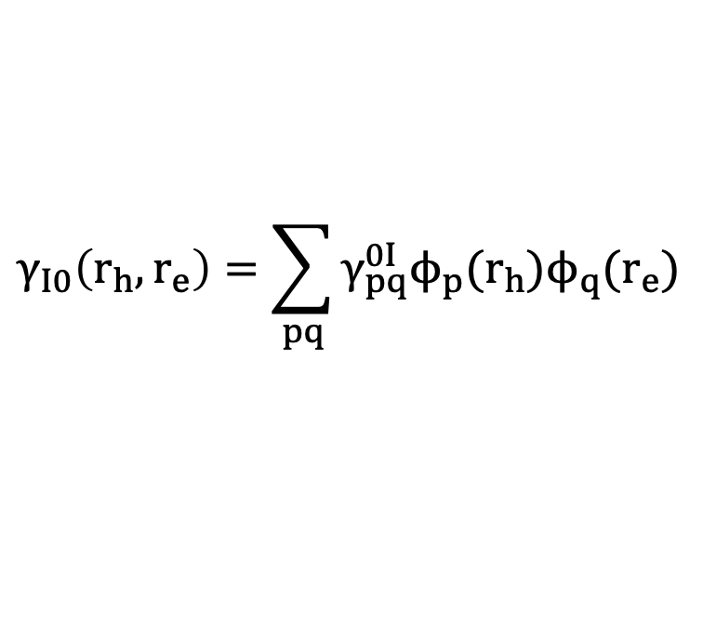
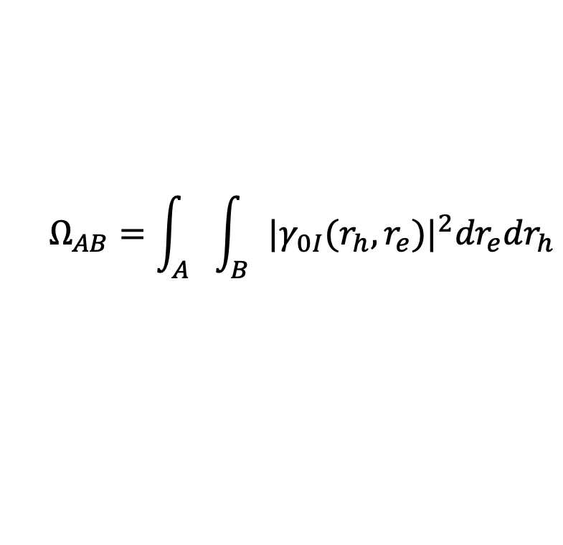
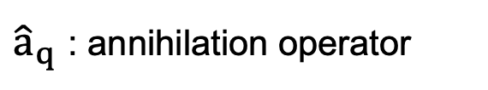
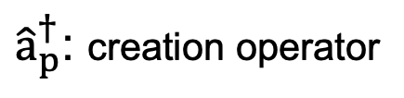
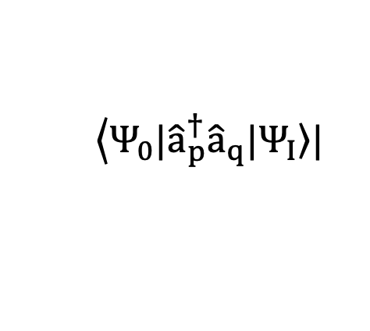
In real space & orthonormal MO basis
One-electron transition density matrix
$$γ_{I0}\left(r_{h},r_{e}\right)=\sum_{pq}{γ_{pq}^{0I}ϕ_{p}(r_{h})ϕ_{q}(r_{e})}$$
$$\left\langle Ψ_{0}|{\hat{a}}_{p}^{†}{\hat{a}}_{q}|\left.Ψ_{I}\right\rangle \right.|$$
${\hat{a}}_{p}^{†}$: creation operator
Libra Summer School 2024
${\hat{a}}_{q}$ : annihilation operator
Löwdin orthogonalization
$$Ω_{AB}=\int_{A}{\int_{B}{{|γ_{0I}(r_{h},r_{e})|}^{2}{dr}_{e}{dr}_{h}}}$$
Dóra Vörös
Notes:
To this end, in the following we will heavily use the oneelectron transition density matrix (1TDM) TIJ, whose elements in general can be defined as
Here, a^y r is the creation operator for orbital /r; a^s the annihilation operator for orbital /s, and I and J are two excited state indices. We will mostly consider transition density matrices between the ground state and an excited state I, which we write as T
The number of non-vanishing orbital: sign of multiconfigurational character
Using the 1TDM, we can now proceed to decompose the excitation into different local and CT contributions. For this purpose, we compute the charge transfer numbers.
where the hole is restricted to a fragment A of the system and the electron to fragment B. Practically speaking, the integral in Eq. (2) is evaluated using a population analysis scheme leading to straightforward matrix operations, and one can either use a formula8,25 analogous to Mayer’s bond order47 or work with Löwdin orthogonalization.4

Slide 13
Gas phase spectrum
Intense absorption band at low energy (~3.3 eV)
Separated from higher bands (like in experimental)
Libra Summer School 2024
Dóra Vörös
Vörös, D., F. Proché, C., Mai, S., & González, L. (2024). Hydrogen bonding to the electron accepting group controls the absorption spectrum of a push--pull stilbene adsorbed on amorphous silica. accepted
Notes:
To this end, in the following we will heavily use the oneelectron transition density matrix (1TDM) TIJ, whose elements in general can be defined as
Here, a^y r is the creation operator for orbital /r; a^s the annihilation operator for orbital /s, and I and J are two excited state indices. We will mostly consider transition density matrices between the ground state and an excited state I, which we write as T

Slide 14
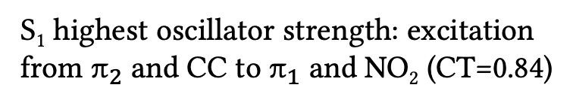
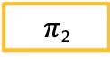

Gas phase spectrum
NMe₂
NO₂
S₁ highest oscillator strength: excitation from $π_{2}$ and CC to $π_{1}$ and NO₂ (CT=0.84)
$π$₂
CC
$π$₁
Libra Summer School 2024
S₁
Hole
Electron
Dóra Vörös
Notes:
To this end, in the following we will heavily use the oneelectron transition density matrix (1TDM) TIJ, whose elements in general can be defined as
Here, a^y r is the creation operator for orbital /r; a^s the annihilation operator for orbital /s, and I and J are two excited state indices. We will mostly consider transition density matrices between the ground state and an excited state I, which we write as T

Slide 15
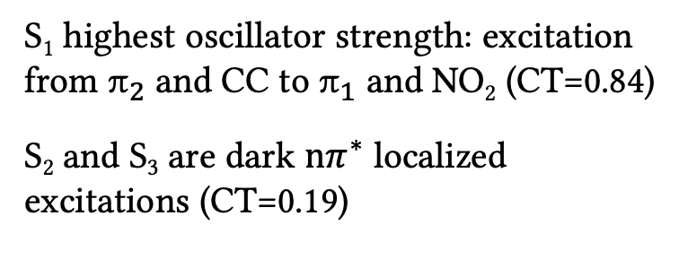
Gas phase spectrum
NMe₂
NO₂
S₁ highest oscillator strength: excitation from $π_{2}$ and CC to $π_{1}$ and NO₂ (CT=0.84)
S₂ and S₃ are dark $nπ^{∗}$ localized excitations (CT=0.19)
$π$₂
CC
$π$₁
Libra Summer School 2024
S₂
Hole
Electron
Dóra Vörös
Notes:
To this end, in the following we will heavily use the oneelectron transition density matrix (1TDM) TIJ, whose elements in general can be defined as
Here, a^y r is the creation operator for orbital /r; a^s the annihilation operator for orbital /s, and I and J are two excited state indices. We will mostly consider transition density matrices between the ground state and an excited state I, which we write as T

Slide 16
Variety in the spectra
trans-DANS
cis-DANS
Bride range of spectral shifts
Position of first bright CT state varies ~0.8 eV (trans) and 1.2 eV (cis)
Intensity of bands varies
Significant effect on electronic excitation
Libra Summer School 2024
Dóra Vörös
Notes:
Easter eggs are hidden references, clues, or inside jokes placed in media such as TV shows, movies, video games, and websites.¹³ They are often hard to spot and may reveal new details about the story or pay homage to an inspiration that the creators loved.

Slide 17
K-Means clustering ONLY with electron-hole correlation matrix
K-Means clustering → principal component analysis
Libra Summer School 2024
Dóra Vörös
Notes:
Easter eggs are hidden references, clues, or inside jokes placed in media such as TV shows, movies, video games, and websites.¹³ They are often hard to spot and may reveal new details about the story or pay homage to an inspiration that the creators loved.

Slide 18
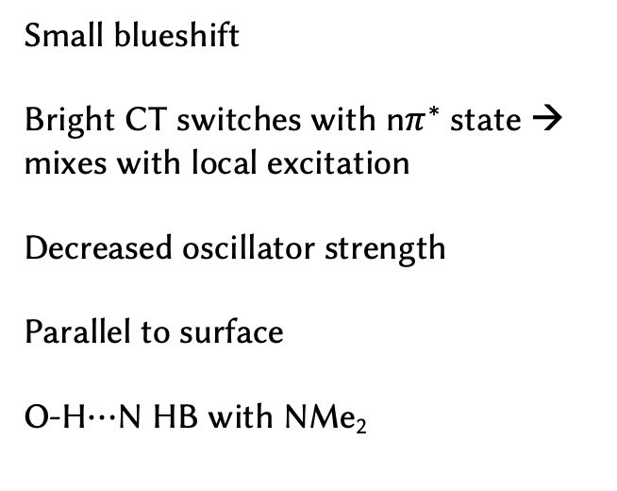
K-Means clustering with electron-hole correlation matrix
Clustering → principal component analysis
Small blueshift
Bright CT switches with n$π^{∗}$ state → mixes with local excitation
Decreased oscillator strength
Parallel to surface
O-H$⋯$N HB with NMe₂
Hole
Libra Summer School 2024
Electron
Dóra Vörös
Notes:
Easter eggs are hidden references, clues, or inside jokes placed in media such as TV shows, movies, video games, and websites.¹³ They are often hard to spot and may reveal new details about the story or pay homage to an inspiration that the creators loved.

Slide 19
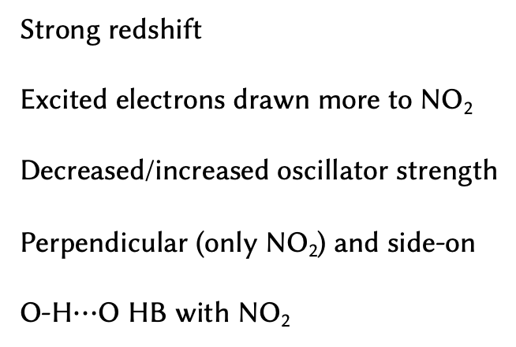
K-Means clustering with electron-hole correlation matrix
Clustering → principal component analysis
Strong redshift
Excited electrons drawn more to NO₂
Decreased/increased oscillator strength
Perpendicular (only NO₂) and side-on
O-H$⋯$O HB with NO₂
Hole
Libra Summer School 2024
Electron
Dóra Vörös
Notes:
Easter eggs are hidden references, clues, or inside jokes placed in media such as TV shows, movies, video games, and websites.¹³ They are often hard to spot and may reveal new details about the story or pay homage to an inspiration that the creators loved.

Slide 20
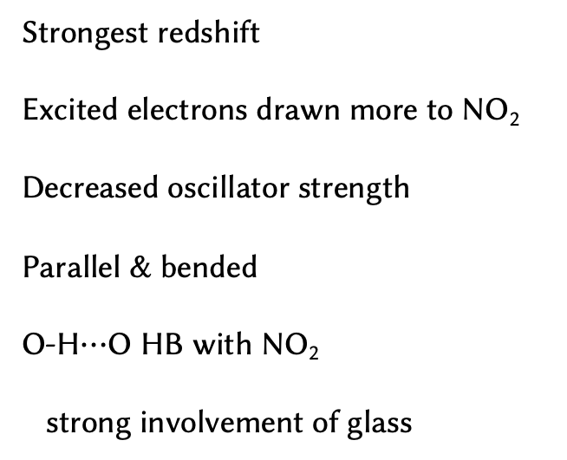
K-Means clustering with electron-hole correlation matrix
Clustering → principal component analysis
Strongest redshift
Excited electrons drawn more to NO₂
Decreased oscillator strength
Parallel & bended
O-H$⋯$O HB with NO₂
strong involvement of glass
Hole
Libra Summer School 2024
Electron
Dóra Vörös
Notes:
Easter eggs are hidden references, clues, or inside jokes placed in media such as TV shows, movies, video games, and websites.¹³ They are often hard to spot and may reveal new details about the story or pay homage to an inspiration that the creators loved.

Slide 21
Decomposition analysis
Molecule optimized in gas phase and spectrum in gas phase
Molecule optimized with glass and glass replaced by point charges
Molecule optimized with glass and glass removed
Molecule optimized with glass and full QM
Libra Summer School 2024
Dóra Vörös
Notes:
Easter eggs are hidden references, clues, or inside jokes placed in media such as TV shows, movies, video games, and websites.¹³ They are often hard to spot and may reveal new details about the story or pay homage to an inspiration that the creators loved.

Slide 22

Decomposition analysis
+
-
O-H$⋯N$
Reduced the electron donor capacity of NMe₂
Reduces CT character (increased localization on the nitrophenyl)
Larger part of interaction is from electrostatic part
Blueshift
Libra Summer School 2024
Dóra Vörös
Notes:
Easter eggs are hidden references, clues, or inside jokes placed in media such as TV shows, movies, video games, and websites.¹³ They are often hard to spot and may reveal new details about the story or pay homage to an inspiration that the creators loved.

Slide 23

Decomposition analysis
+
-
O-H$⋯$O
Stabilizing the excited electron on NO₂
Enhances push-pull properties (increased CT)
Large part of interaction is from electrostatic part
Strong redshift
Libra Summer School 2024
Dóra Vörös
Notes:
Easter eggs are hidden references, clues, or inside jokes placed in media such as TV shows, movies, video games, and websites.¹³ They are often hard to spot and may reveal new details about the story or pay homage to an inspiration that the creators loved.

Slide 24
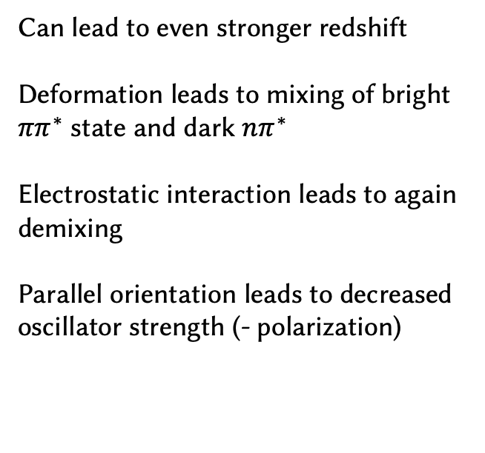
Decomposition analysis
+
-
Parallel
Can lead to even stronger redshift
Deformation leads to mixing of bright $ππ^{∗}$ state and dark $nπ^{∗}$
Electrostatic interaction leads to again demixing
Parallel orientation leads to decreased oscillator strength (- polarization)
Libra Summer School 2024
Dóra Vörös
Notes:
Easter eggs are hidden references, clues, or inside jokes placed in media such as TV shows, movies, video games, and websites.¹³ They are often hard to spot and may reveal new details about the story or pay homage to an inspiration that the creators loved.

Slide 25



Conclusion
C-H$⋯$O
O-H$⋯$O
O-H$⋯N$
bended
O-H$⋯π$
Libra Summer School 2024
The strongest interaction, HB to NO₂ has the largest effect
HB reinforces the push-pull effect → redshift
Dóra Vörös
Notes:
Easter eggs are hidden references, clues, or inside jokes placed in media such as TV shows, movies, video games, and websites.¹³ They are often hard to spot and may reveal new details about the story or pay homage to an inspiration that the creators loved.

Slide 26
Goals
https://doi.org/10.1021/acs.jpcc.3c05552
How does the molecule adsorb on the glass? Stable and unstable orientations?
Accepted and soon online
Libra Summer School 2024
How does the absorption spectrum vary depending on the adsorption modes?
How does the nonradiative vs. radiative ratio change upon adsorption?
Dóra Vörös
Notes:
Easter eggs are hidden references, clues, or inside jokes placed in media such as TV shows, movies, video games, and websites.¹³ They are often hard to spot and may reveal new details about the story or pay homage to an inspiration that the creators loved.

Slide 27
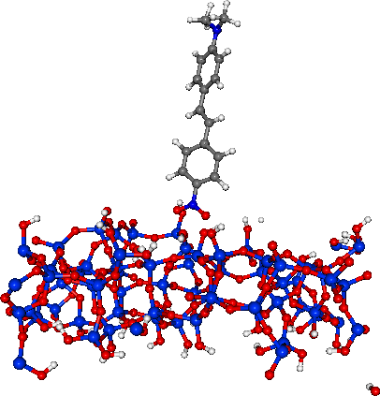
1st Challenge: Solid state with big unit cell
Can we do periodic system for the excited state dynamics?
What alternatives are?
Libra Summer School 2024
Dóra Vörös
Notes:
Easter eggs are hidden references, clues, or inside jokes placed in media such as TV shows, movies, video games, and websites.¹³ They are often hard to spot and may reveal new details about the story or pay homage to an inspiration that the creators loved.

Slide 28
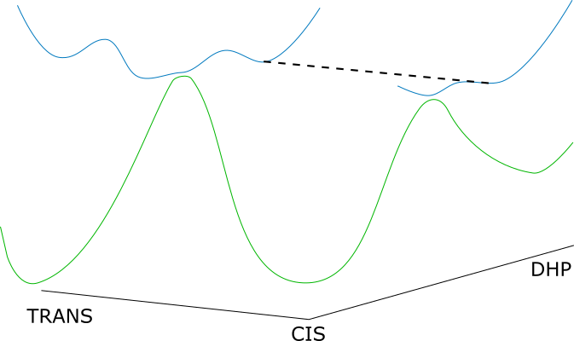
2nd Challenge: Conical intersection with ground state
We need multireference method
But it should not be to expensive
Libra Summer School 2024
Dóra Vörös
Notes:
Easter eggs are hidden references, clues, or inside jokes placed in media such as TV shows, movies, video games, and websites.¹³ They are often hard to spot and may reveal new details about the story or pay homage to an inspiration that the creators loved.

Slide 29



Thank you for your attention!
Prof. Cesare Franchini
Libra Summer School 2024
Andrea Angeletti
Felix Proché
Dóra Vörös
Notes:
Easter eggs are hidden references, clues, or inside jokes placed in media such as TV shows, movies, video games, and websites.¹³ They are often hard to spot and may reveal new details about the story or pay homage to an inspiration that the creators loved.

Slide 30
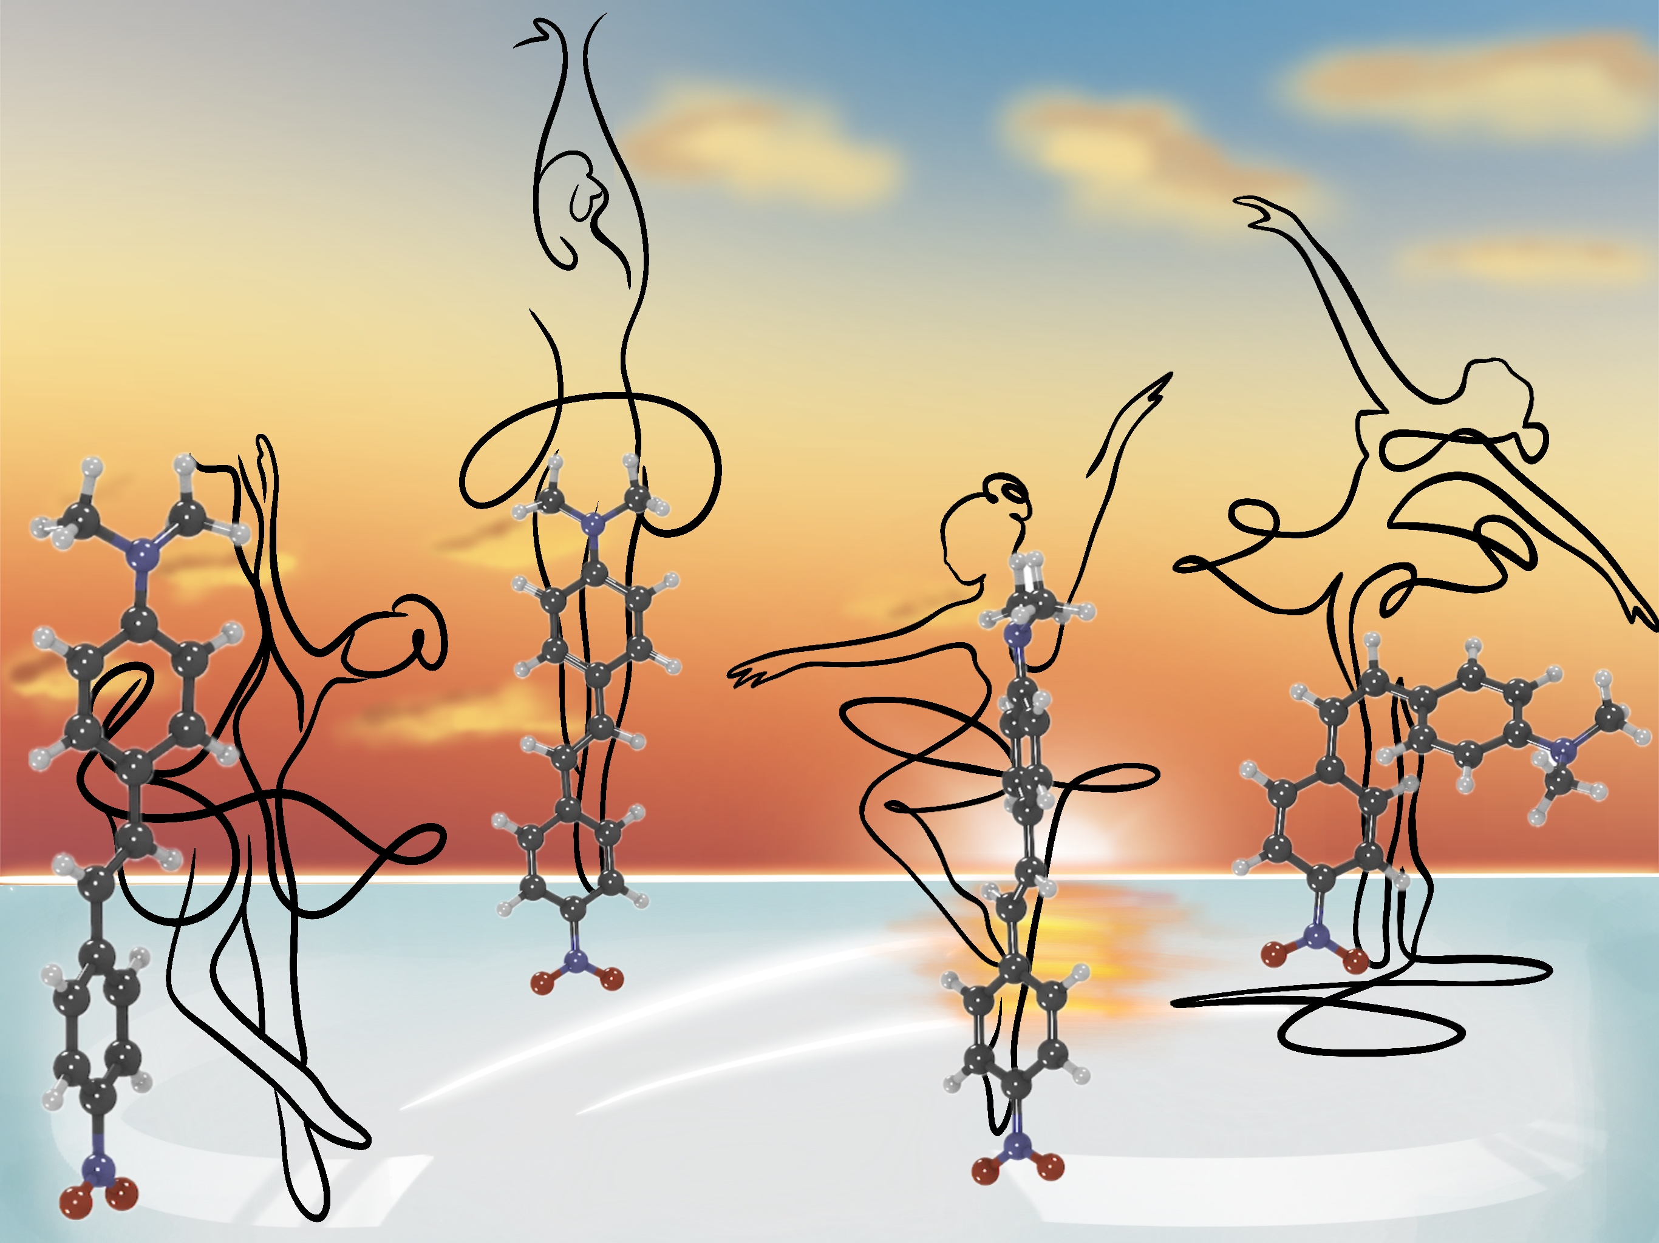
Libra Summer School 2024
Dóra Vörös
Notes:
Easter eggs are hidden references, clues, or inside jokes placed in media such as TV shows, movies, video games, and websites.¹³ They are often hard to spot and may reveal new details about the story or pay homage to an inspiration that the creators loved.

Slide 31
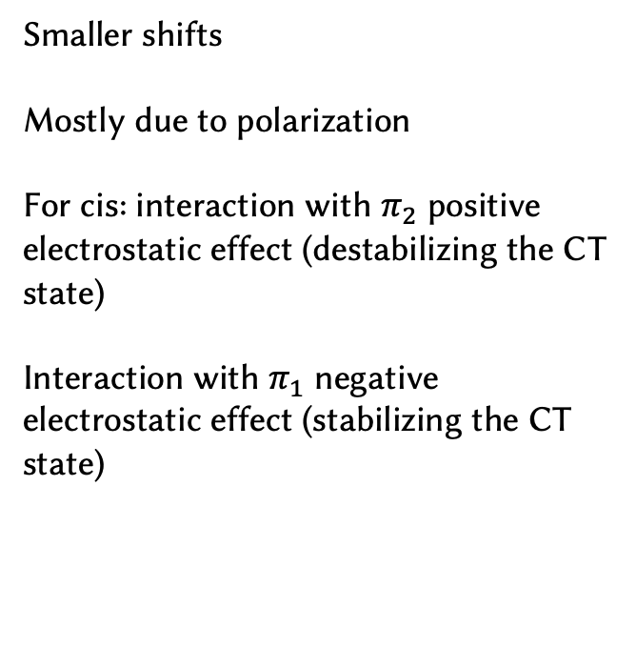

Decomposition analysis
+
-
O-H$⋯π$
Smaller shifts
Mostly due to polarization
For cis: interaction with $π_{2}$ positive electrostatic effect (destabilizing the CT state)
Interaction with $π_{1}$ negative electrostatic effect (stabilizing the CT state)
Libra Summer School 2024
Dóra Vörös
Notes:
Easter eggs are hidden references, clues, or inside jokes placed in media such as TV shows, movies, video games, and websites.¹³ They are often hard to spot and may reveal new details about the story or pay homage to an inspiration that the creators loved.

Slide 32
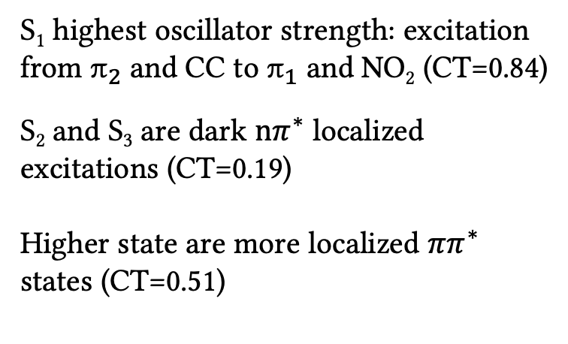
Gas phase spectrum
NMe₂
NO₂
S₁ highest oscillator strength: excitation from $π_{2}$ and CC to $π_{1}$ and NO₂ (CT=0.84)
S₂ and S₃ are dark $nπ^{∗}$ localized excitations (CT=0.19)
Higher state are more localized $ππ^{∗}$ states (CT=0.51)
$π$₂
CC
$π$₁
Libra Summer School 2024
S₅
Hole
Electron
Dóra Vörös
Notes:
To this end, in the following we will heavily use the oneelectron transition density matrix (1TDM) TIJ, whose elements in general can be defined as
Here, a^y r is the creation operator for orbital /r; a^s the annihilation operator for orbital /s, and I and J are two excited state indices. We will mostly consider transition density matrices between the ground state and an excited state I, which we write as T

Slide 33
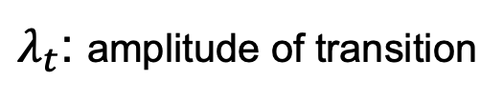
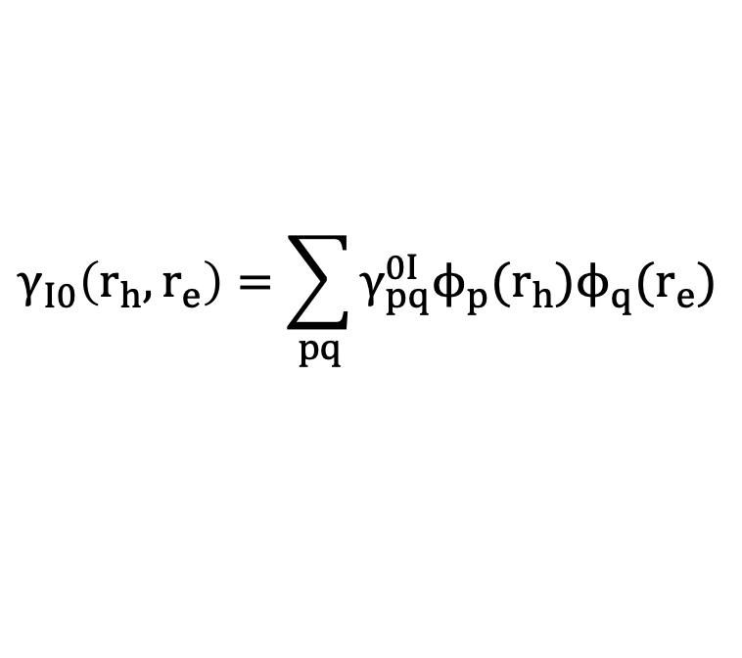
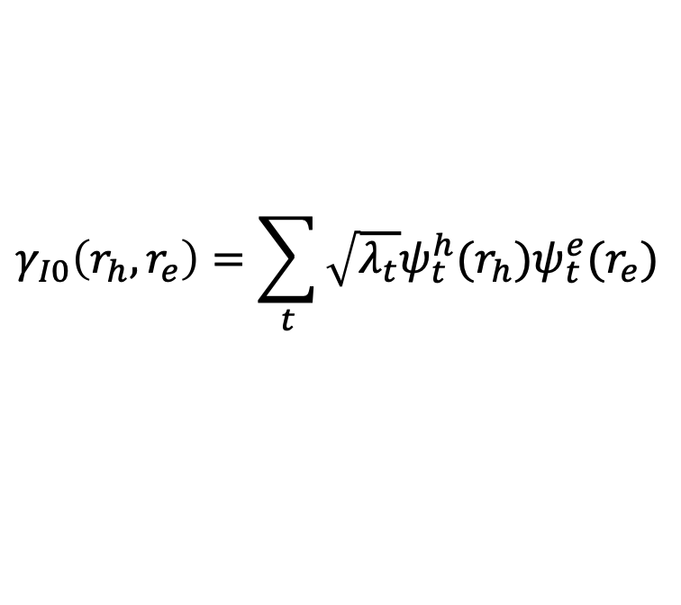
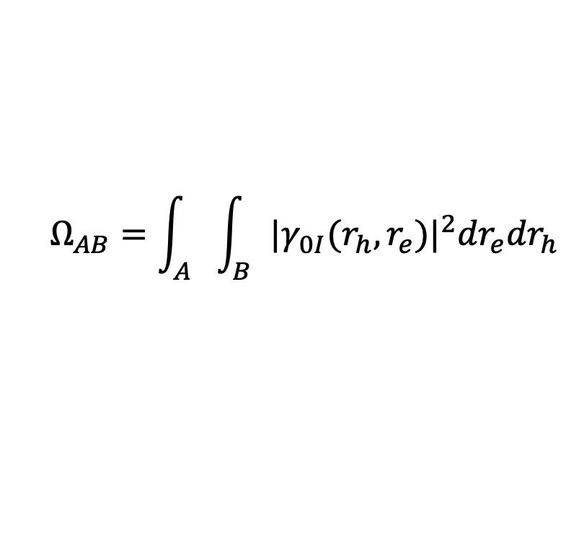
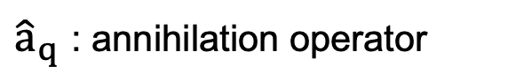
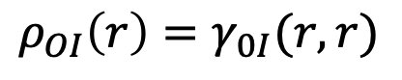
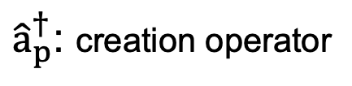
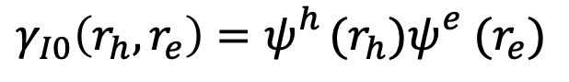
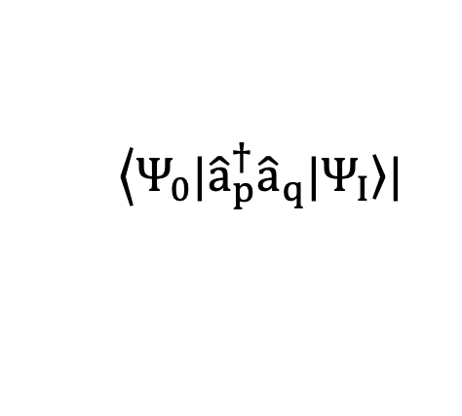
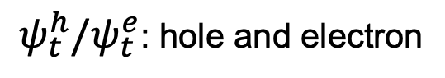
In real space & orthonormal MO basis
Singular value decomposition
One-electron transition density matrix
Natural transition orbitals
$$γ_{I0}\left(r_{h},r_{e}\right)=\sum_{pq}{γ_{pq}^{0I}ϕ_{p}(r_{h})ϕ_{q}(r_{e})}$$
$$γ_{I0}\left(r_{h},r_{e}\right)=\sum_{t}{\sqrt{λ_{t}}ψ_{t}^{h}(r_{h})ψ_{t}^{e}(r_{e})}$$
$λ_{t}$: amplitude of transition
$$\left\langle Ψ_{0}|{\hat{a}}_{p}^{†}{\hat{a}}_{q}|\left.Ψ_{I}\right\rangle \right.|$$
1NTO
$ψ_{t}^{h}/ψ_{t}^{e}$: hole and electron
${\hat{a}}_{p}^{†}$: creation operator
Libra Summer School 2024
${\hat{a}}_{q}$ : annihilation operator
$$γ_{I0}\left(r_{h},r_{e}\right)=ψ_{}^{h}(r_{h})ψ_{}^{e}(r_{e})$$
Löwdin orthogonalization
Diagonal part
$$Ω_{AB}=\int_{A}{\int_{B}{{|γ_{0I}(r_{h},r_{e})|}^{2}{dr}_{e}{dr}_{h}}}$$
$$ρ_{OI}\left(r\right)=γ_{0I}(r,r)$$
Transition density: Energetics of a state and how strongly it interact with light
Dóra Vörös
Notes:
To this end, in the following we will heavily use the oneelectron transition density matrix (1TDM) TIJ, whose elements in general can be defined as
Here, a^y r is the creation operator for orbital /r; a^s the annihilation operator for orbital /s, and I and J are two excited state indices. We will mostly consider transition density matrices between the ground state and an excited state I, which we write as T
The number of non-vanishing orbital: sign of multiconfigurational character
Using the 1TDM, we can now proceed to decompose the excitation into different local and CT contributions. For this purpose, we compute the charge transfer numbers.
where the hole is restricted to a fragment A of the system and the electron to fragment B. Practically speaking, the integral in Eq. (2) is evaluated using a population analysis scheme leading to straightforward matrix operations, and one can either use a formula8,25 analogous to Mayer’s bond order47 or work with Löwdin orthogonalization.4

Slide 34

Decomposition analysis
+
-
C-H$⋯$O
Almost zero deformation
Electrostatic part is positive (diminishes density on H)
Diminished push-pull effect
Larger part of interaction is from polarization
Small redshift
Libra Summer School 2024
Dóra Vörös
Notes:
Easter eggs are hidden references, clues, or inside jokes placed in media such as TV shows, movies, video games, and websites.¹³ They are often hard to spot and may reveal new details about the story or pay homage to an inspiration that the creators loved.

Slide 35
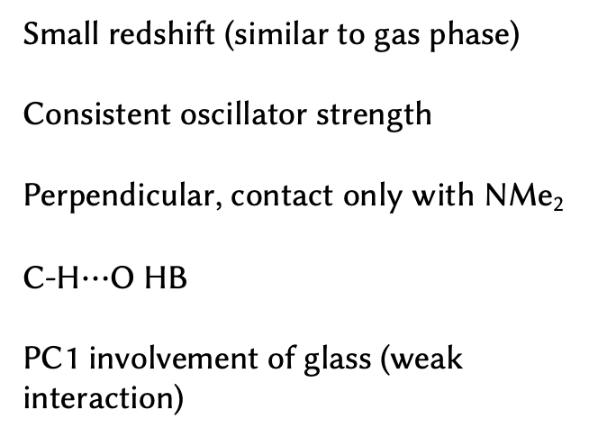
K-Means clustering with electron-hole correlation matrix
Clustering → principal component analysis
Small redshift (similar to gas phase)
Consistent oscillator strength
Perpendicular, contact only with NMe₂
C-H$⋯$O HB
PC1 involvement of glass (weak interaction)
Hole
Libra Summer School 2024
Electron
Dóra Vörös
Notes:
Easter eggs are hidden references, clues, or inside jokes placed in media such as TV shows, movies, video games, and websites.¹³ They are often hard to spot and may reveal new details about the story or pay homage to an inspiration that the creators loved.

Slide 36
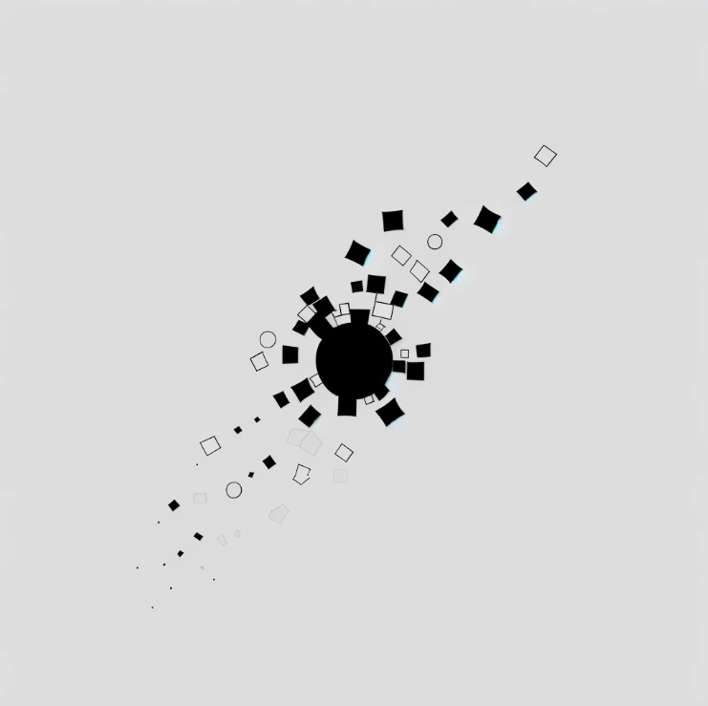

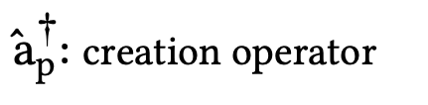



Gas phase spectrum
One-electron transition density matrix
$$γ_{I0}\left(r_{h},r_{e}\right)=\sum_{pq}{γ_{pq}^{0I}ϕ_{p}(r_{h})ϕ_{q}(r_{e})}$$
Singular value decomposition of 1TDM
Transform to AO basis
Löwdin orthogonalization
$$\left\langle Ψ_{0}|{\hat{a}}_{p}^{†}{\hat{a}}_{q}|\left.Ψ_{I}\right\rangle \right.|$$
${\hat{a}}_{p}^{†}$: creation operator
Group Seminar 2024 SS
${\hat{a}}_{q}$ : annihilation operator
Dóra Vörös
Notes:
To this end, in the following we will heavily use the oneelectron transition density matrix (1TDM) TIJ, whose elements in general can be defined as
Here, a^y r is the creation operator for orbital /r; a^s the annihilation operator for orbital /s, and I and J are two excited state indices. We will mostly consider transition density matrices between the ground state and an excited state I, which we write as T

Slide 37
Research Question
?
How the photophysics/photochemistry of DANS is influenced when it is adsorbed on glass?
Group Seminar 2024 SS
Fragmentation
Dóra Vörös
Notes:
Easter eggs are hidden references, clues, or inside jokes placed in media such as TV shows, movies, video games, and websites.¹³ They are often hard to spot and may reveal new details about the story or pay homage to an inspiration that the creators loved.

Slide 38

K-Means clustering with electron-hole correlation matrix
Clustering → principal component analysis
Small redshift
Reduced CT character
Decreased oscillator strength
Parallel to surface
O-H$⋯$O HB with NO₂ &
O-H$⋯π$ with CC
Group Seminar 2024 SS
Hole
Electron
Dóra Vörös
Notes:
Easter eggs are hidden references, clues, or inside jokes placed in media such as TV shows, movies, video games, and websites.¹³ They are often hard to spot and may reveal new details about the story or pay homage to an inspiration that the creators loved.

Slide 39

K-Means clustering with electron-hole correlation matrix
Clustering → principal component analysis
Strong redshift
Excited electrons drawn more to NO₂
Excited electrons localized in the $π$ system
Decreased oscillator strength
Parallel
O-H$⋯$O HB with NO₂ &
O-H$⋯π$ with rings
Group Seminar 2024 SS
Hole
Electron
Dóra Vörös
Notes:
Easter eggs are hidden references, clues, or inside jokes placed in media such as TV shows, movies, video games, and websites.¹³ They are often hard to spot and may reveal new details about the story or pay homage to an inspiration that the creators loved.

Slide 40
K-Means clustering with electron-hole correlation matrix
Clustering → principal component analysis
Group Seminar 2024 SS
Dóra Vörös
Notes:
Easter eggs are hidden references, clues, or inside jokes placed in media such as TV shows, movies, video games, and websites.¹³ They are often hard to spot and may reveal new details about the story or pay homage to an inspiration that the creators loved.

